Slide 1
Devtools
Jose Andres Giron Giron
WDD 230
BYUi

Slide 2
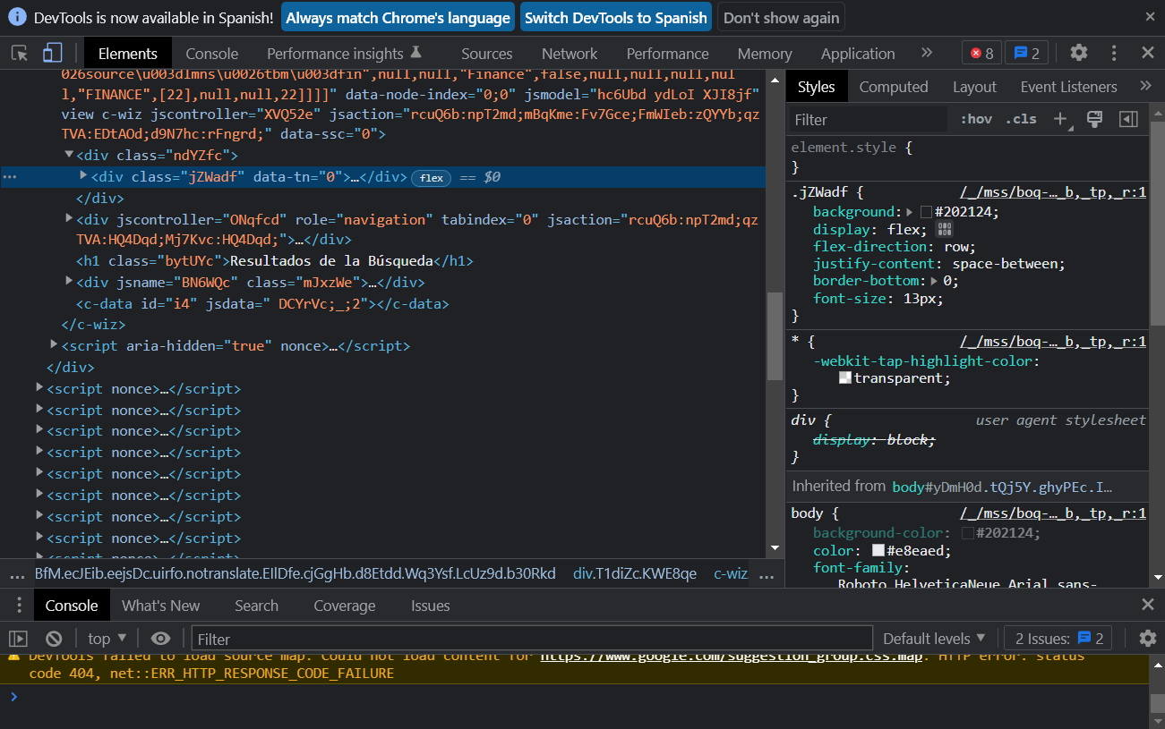
What is it?
Based on Chrome Developers It’s “a set of web developer tools built directly into the Google Chrome browser.” It “can help you edit pages on-the-fly and diagnose problems quickly, which ultimately helps you build better websites, faster.”

Slide 3
Open DevTools
DOM or CSS:
Right-click an element on the page and select Inspect to jump into the Elements panel. Or press Command+Option+C (Mac) or Control+Shift+C (Windows, Linux, ChromeOS).
Logged messages or run JavaScript:
Press Command+Option+J (Mac) or Control+Shift+J (Windows, Linux, ChromeOS) to jump straight into the Console

Slide 4
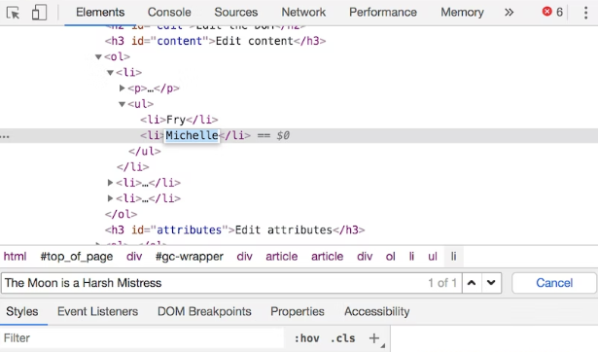
How to debug in the DOM?
Inspect a node
Right click on the element and hit inspect
Edit the DOM
Change order of nodes
Hide nodes (H)
Delete a Node

Slide 5
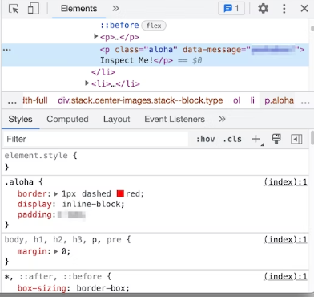

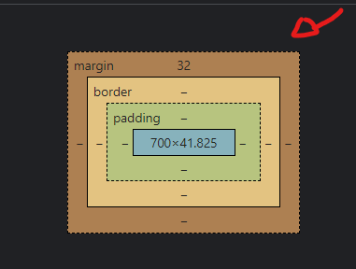
How to change Styles with Devtools?
View an element's CSS
Add a CSS declaration to an element
Copy style from one element to another
Add a class
Box model

Slide 6
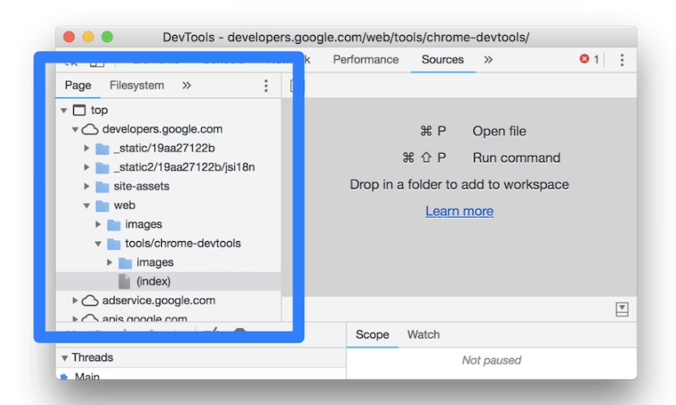
Sources
This is where you can view files

Slide 7
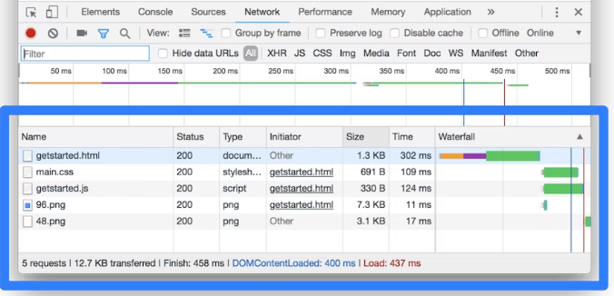



Inspect Network

Slide 8
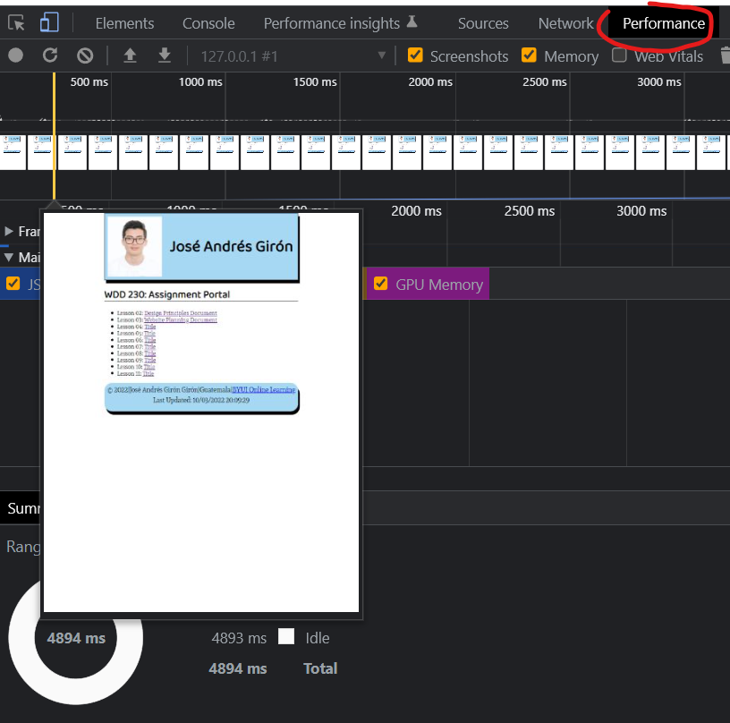
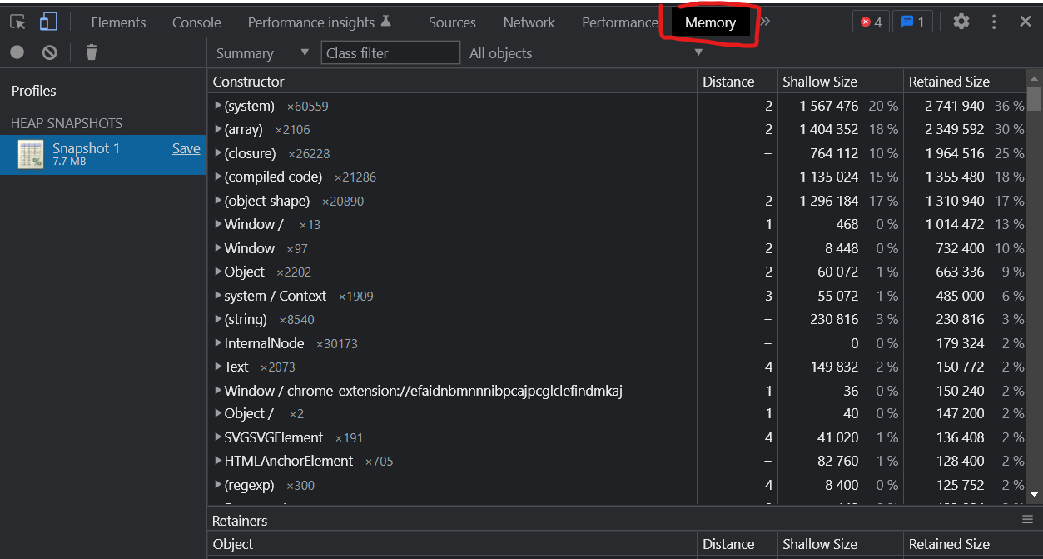
Performance and Memory

